Slide 1
HEDGING PROJECT
Weijia Deng
Kai Yang
Jianda Bi

Slide 2
Summary of the process
1. In this hedging project, we start by implementing the minimum variance hedge for a single stock (we choose IBM) and a market ETF (we choose the SPY ETF).
2.After hedging for a single stock and single hedging security, we decide to hedge for a portfolio and a set of hedging securities.

Slide 3
Summary of the process
3. Next, we consider a fixed income portfolio that consists of corporate bonds and hedge it with the appropriate hedging security .
4. Finally, we explore the problem of hedging inflation.

Slide 4
Portfolio Hedge (MS,PFK,BLK, CS,GS,ICE,MET,KCG,APO,FIG)
 | return | csj | iyf | spy
Date
2016/1/5 | -0.003546 | -0.000478 | 0.004499 | 0.001691
2016/1/6 | -0.017614 | 0.000765 | -0.013552 | -0.012614
2016/1/7 | -0.034297 | 0.000382 | -0.027128 | -0.023992
2016/1/8 | -0.017493 | 0.000669 | -0.015438 | -0.010977
2016/1/11 | 0.003983 | -0.000286 | 0.003525 | 0.00099
2016/1/12 | 0.009038 | -0.000382 | 0.005208 | 0.008068
2016/1/13 | -0.028971 | 0.000382 | -0.026389 | -0.024941
... | ... | ... | ... | ...
2016/12/20 | 0.016855 | 0.000478 | 0.008798 | 0.003858
2016/12/21 | -0.008858 | 0.00086 | -0.010368 | -0.002783
2016/12/22 | -0.010789 | -0.000477 | -0.001762 | -0.001727
2016/12/23 | -0.001605 | -0.000095 | 0.001569 | 0.001464
2016/12/27 | 0.003762 | -0.000668 | 0.001077 | 0.002481
2016/12/28 | -0.011301 | 0.000478 | -0.008511 | -0.008264
2016/12/29 | -0.006501 | 0.000859 | -0.002269 | -0.000223
2016/12/30 | 0.003662 | 0.00124 | 0.003362 | -0.003655
IYF( iShares Dow Jones US Financial ETF)
CSJ（iShares Barclays 1-3 Year Credit Bond ETF)

Slide 5
Fixed Income Hedge
 | return | tlo
Date
2016/1/5 | 0.000527 | -0.003982
2016/1/6 | 0.003947 | 0.012709
2016/1/7 | 0.000786 | 0.001974
2016/1/8 | 0.000786 | 0.004363
2016/1/11 | -0.003227 | -0.010088
2016/1/12 | 0.002275 | 0.012314
2016/1/13 | 0.003056 | 0.010207
... | ... | ...
2016/12/22 | -0.002662 | -0.001315
2016/12/23 | 0.00155 | 0.00117
2016/12/27 | -0.001805 | -0.002484
2016/12/28 | 0.003703 | 0.003809
2016/12/29 | 0.003861 | 0.004086
2016/12/30 | 0.001538 | 0.001308
LQD(iShares iBoxx $ Investment Grade Corporate Bond ETF)
TLO (SPDR Barclays Long Term Treasury ETF)

Slide 6
Inflation Hedge
 | return | gold
DATE
2006/2/1 | 0.000502 | -0.004563
2006/3/1 | 0.001505 | 0.010961
2006/6/1 | 0.002484 | -0.031728
2006/8/1 | 0.004436 | -0.002355
2006/9/1 | -0.004907 | 0.003619
2006/11/1 | 0.000495 | 0.017224
... | ... | ...
2016/6/1 | 0.002005 | 0.00475
2016/7/1 | 0.000233 | 0.0112
2016/8/1 | 0.002047 | 0.01227
2016/9/1 | 0.002567 | -0.006657
2016/11/1 | 0.002089 | 0.008005
2016/12/1 | 0.002568 | -0.015707
CPIAUCSL(Consumer Price Index for All Urban Consumers: All Items)

Slide 7





Minimum Variance Hedge
is the combined hedged position
long IBM stock( ) and long h*SPY futures ( )
h =hedge ratio.

Slide 8
Minimum VaR and CVsR method Separately minimize VaR( ) and CVaR( ) to get the h*.

Slide 9
Hedge for the stock portfolio
Conclusion:
All the methods reduced standard risk and improved performance metric. However, hedged portfolio ended up with lower cumulative return.
After comparing in detail, when it comes to minimize volatility, value at risk and cvar itself, minimizing cvar is better than VaR and Var is better than std.

Slide 10
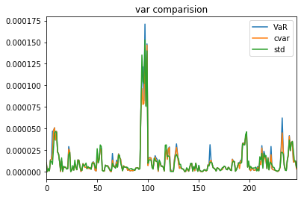
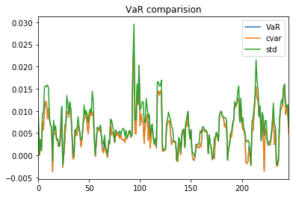
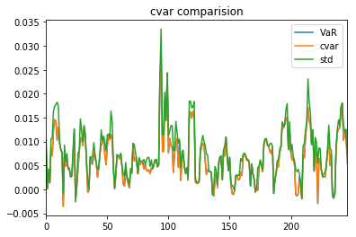
Hedge for the stock portfolio

Slide 11
Hedge for the stock portfolio
Head of detailed data
……

Slide 12
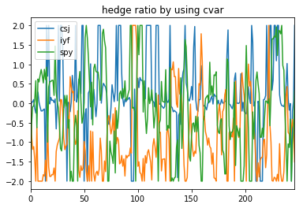
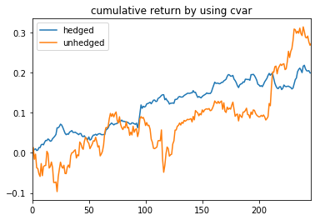
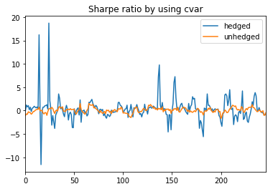
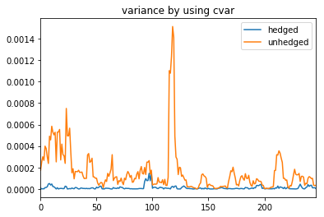
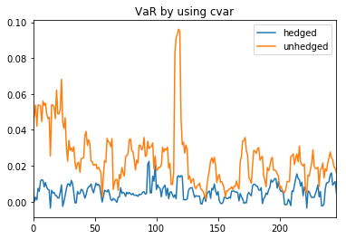
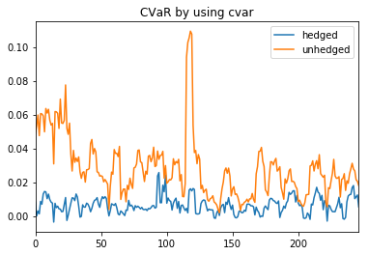
Portfolio—hedged vs unhedged

Slide 13
Hedge for fixed income portfolio
Conclusion:
After comparing in detail, when it comes to minimize volatility, value at risk and cvar itself,
cvar is better than VaR and Var is better than std.
Concluded directly from the graph, risk reduction is not as significant as that in equity case.

Slide 14
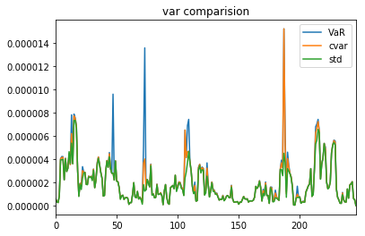
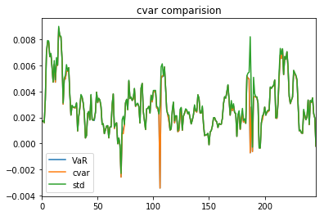
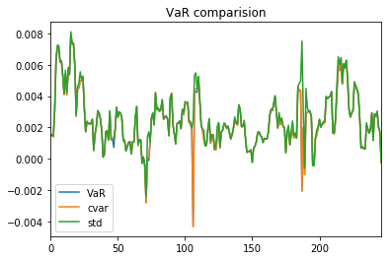
Hedge for fixed income portfolio

Slide 15
Hedge for the stock portfolio
Head of detailed data
……

Slide 16
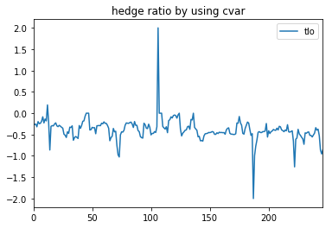
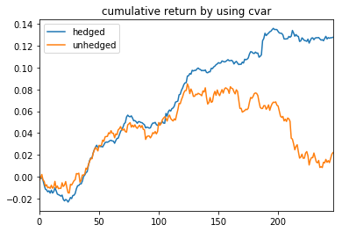
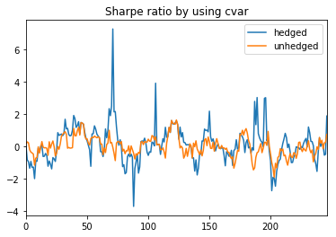
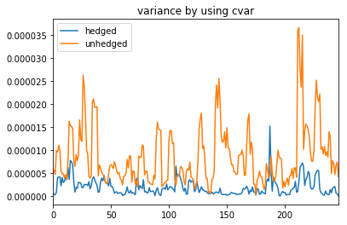
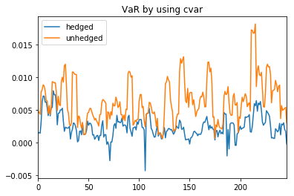
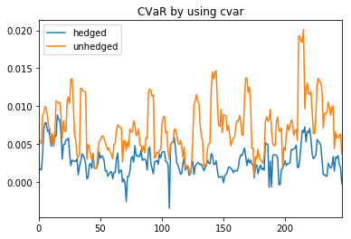
Fixed income—hedged vs unhedged

Slide 17
Hedge against inflation
Tips and spy are not better than gold when it comes to hedging cpi.

Slide 18
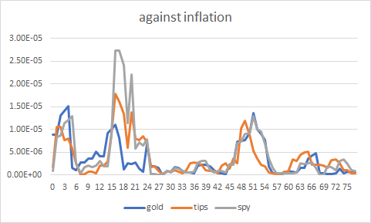
Hedge against inflation

